Slide 1
Claims Git Branching Strategy
25th July 2018

Slide 2
Contents
Branch Types
Branching for…
Story Development
Releases to QA/Staging/Prod
Hotfixes
End-to-End Scenarios
Story Development, QA Defect with Fix, Release
Story Development, Release, Production Defect and Hotfix
How to Perform Actions in Tools
Create branch (and create pull request)
Clone branch
Switch branch (when required)
Commit and push changes
Merge branch (with pull request)
Rollback (revert) pull request

Slide 3
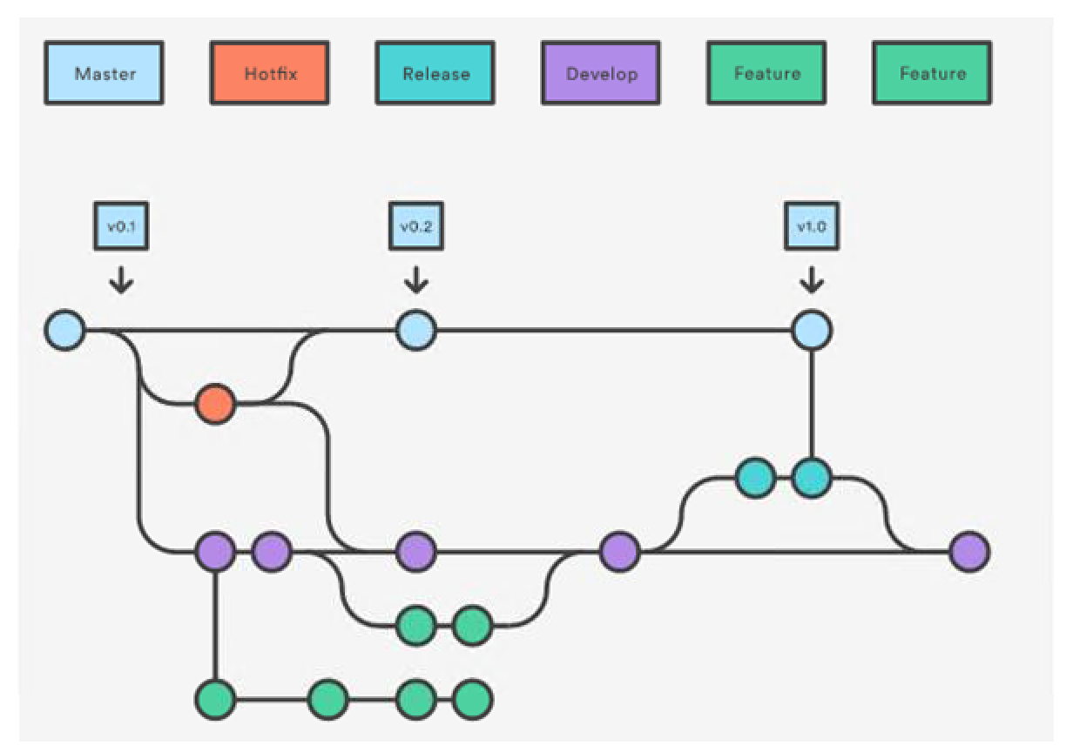
Branch Types
master branch reflects what is in production
develop branch is where merging is done of feature changes and fixes
feature branches are where new stories are developed
release branches are where changes are grouped together for release into QA/Staging/Production
hotfix branches are where emergency production bugs are fixed

Slide 4
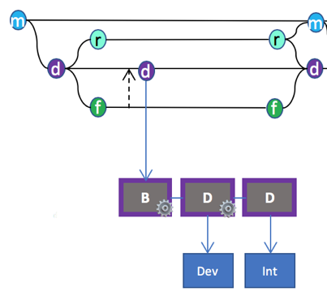
Story Development
1
3
5
2
4
A developer will create a feature branch for each story they work on (in some cases a group of stories may make sense to work on in a single feature branch)
Flow (for each sprint):
Create feature branch from develop for story (or story set)
Commit changes (including unit test and integration bug fixes) to feature branch
Merge changes from feature branch to develop when ready for integration testing
Automated builds from develop branch are deployed to the Dev and Int environments for testing
When you’re finished development, unit and integration testing of feature (there should be no changes in feature branch that have not been merged into develop, built, deployed and tested in Int), merge feature branch into develop (it could live on into next sprint if story is not finished)
Naming standard for feature branch is <work item id> e.g. WI190965
A feature branch ends when story/stories are signed off as ready for QA

Slide 5
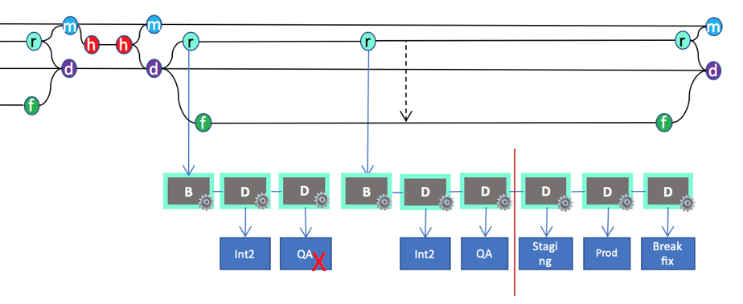
Releases to QA/Staging/Prod
1
1
2
4
5
6
1
3
3
Typically a sprint will deliver a new set of completed stories that are ready for QA – at this point a release branch is created from develop
Bugs reported against the release will be fixed in the release branch
Flow (for each release):
First ensure that all stories to be included in the release have had their feature branches merged into develop, and all previous release branches have been merged into develop, and any hotfix branches (that are ready) are merged into develop
Create a release branch from develop
Automated builds from release branches are deployed to the Int2, QA, Staging, Prod and Breakfix environments
Bug fixes are committed to release branch
Additionally, when possible, the bug fixes should be merged from release into feature branches for next release being tested in Int1
Once release has made it through QA with fixes applied, and the release has been deployed to the Staging and Prod environments, then the release branch is merged into master and develop
Naming standard for release branch is <release id> e.g. R1.0
A release branch ends when release has been deployed to production and passed PPV

Slide 6
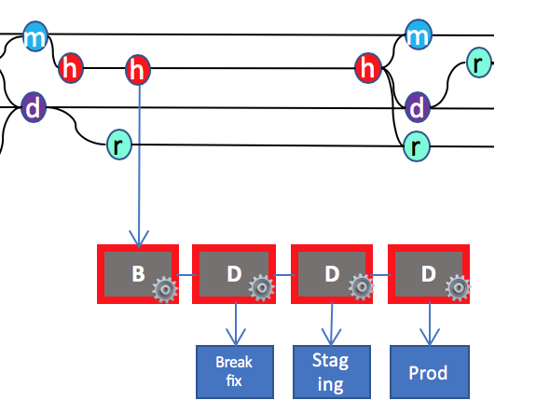
Production Hotfixes
1
2
4
5
3
Production defects that cannot wait for fixes to go through the standard development cycle will require a hotfix branch from master
Flow (for each hotfix):
Create a hotfix branch from master
Bug fixes are committed to hotfix branch
Automated builds from hotfix branch is deployed to the Breakfix environment for testing
Once bug fixes have been signed off, and the build has been deployed to the Staging, Prod environments then they are merged from hotfix into master and develop branches
Additionally, if there is a current release branch in QA, then the bug fixes should be merged from hotfix into the new release so the merged release can be QA tested with the hotfix.
Naming standard for hotfix branch is <release id>-<hotfix id> e.g. R1.0-hotfix1
A hotfix branch ends when fix has been deployed to production and passed PPV

Slide 7
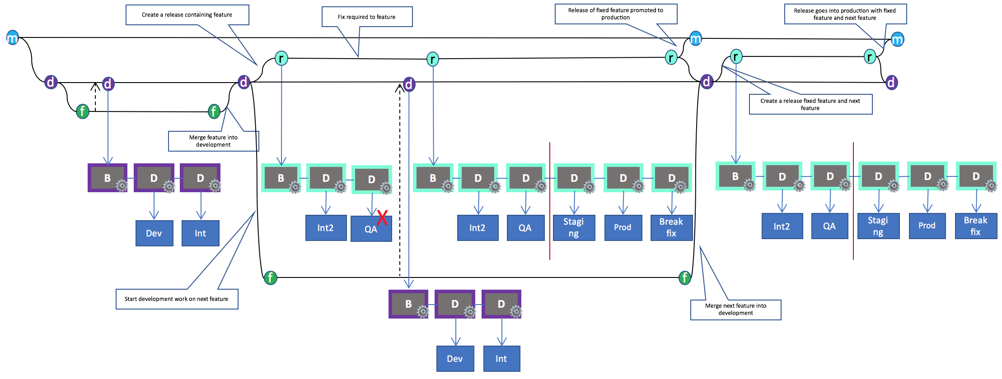
Scenario 1 – Story Development, QA Defect with Fix, Release

Slide 8
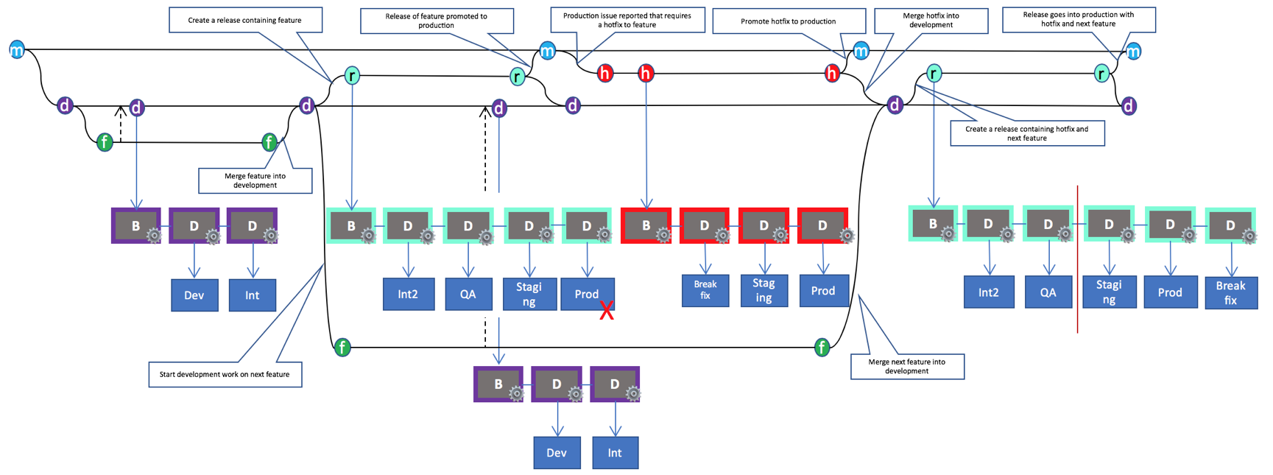
Scenario 2 – Story Development, Release, Production Defect and Hotfix

Slide 9
Actions
Create branch (and create pull request)
Clone branch
Work on new branch
Commit and push changes
Merge branch (with pull request)
Merge conflict
Rollback (revert) pull request

Slide 10
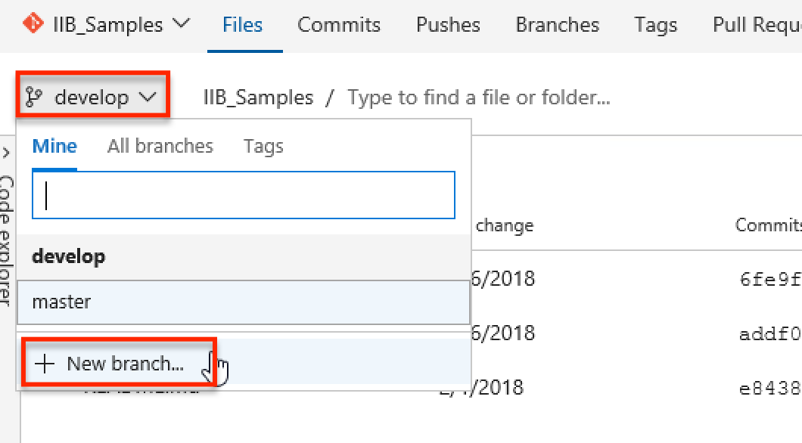
1. Create branch – Select new branch off of develop

Slide 11
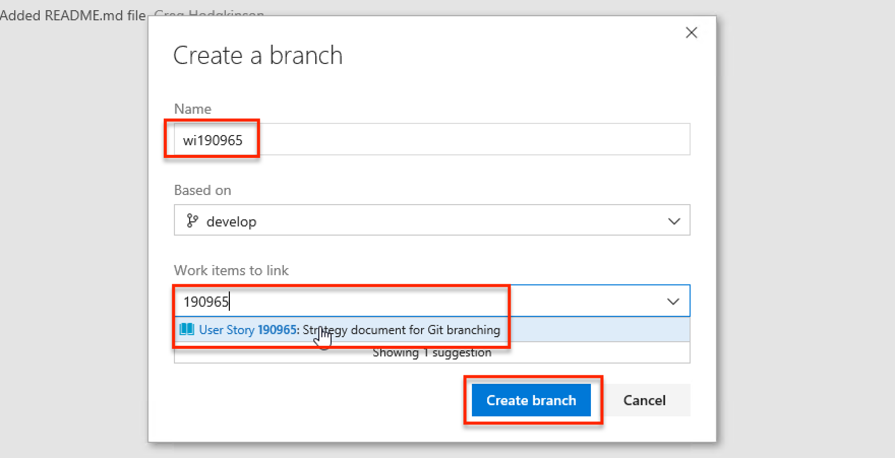
1. Create branch – Name and link to work item

Slide 12
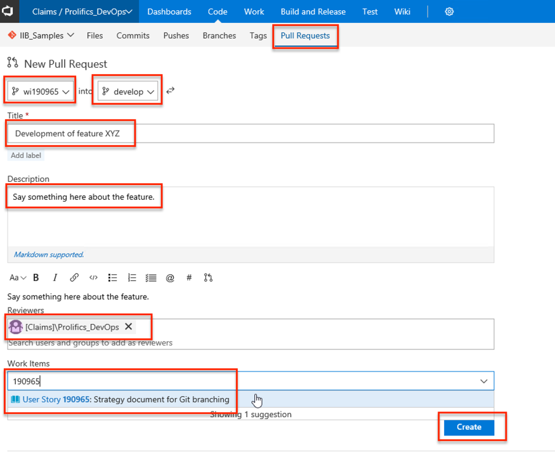
1. Create branch – Finish by creating pull request for collaboration

Slide 13
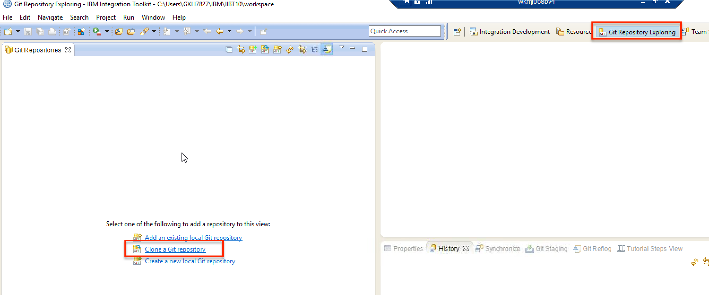
2. Clone branch – Select clone command in Eclipse

Slide 14
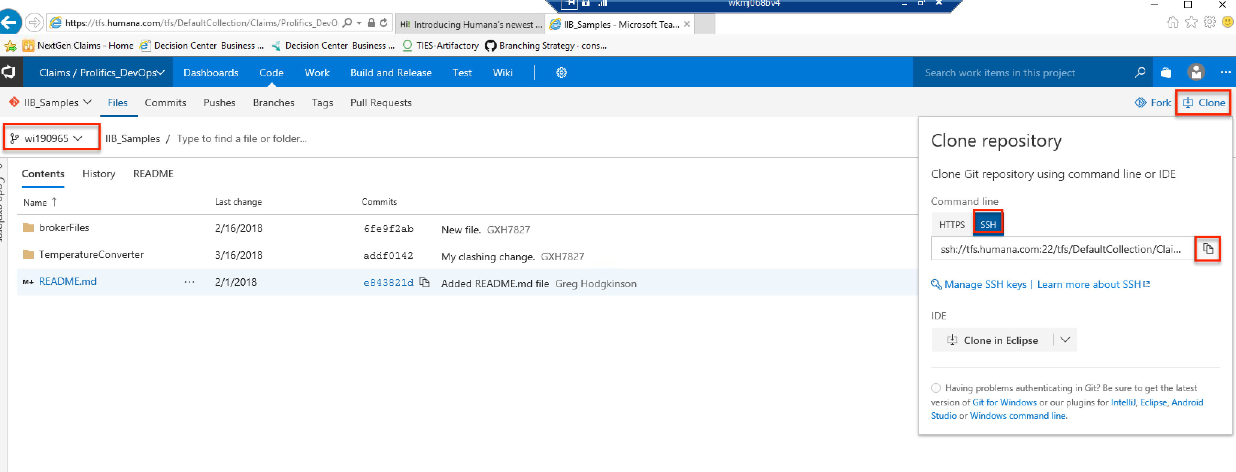
2. Clone branch – Get git repo URL from TFS

Slide 15
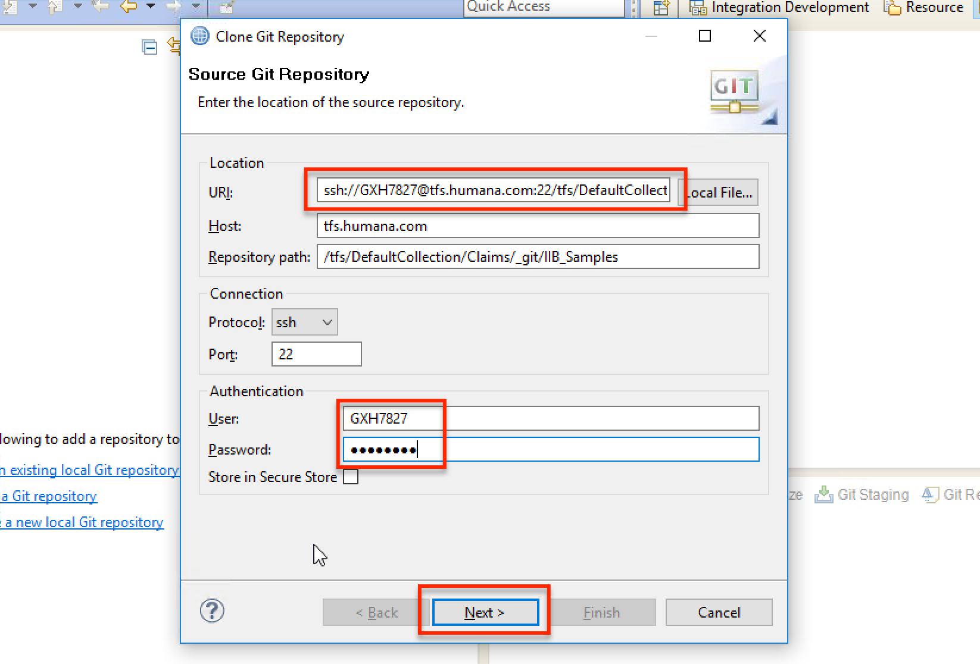
2. Clone branch – Paste repo URL and add creds

Slide 16
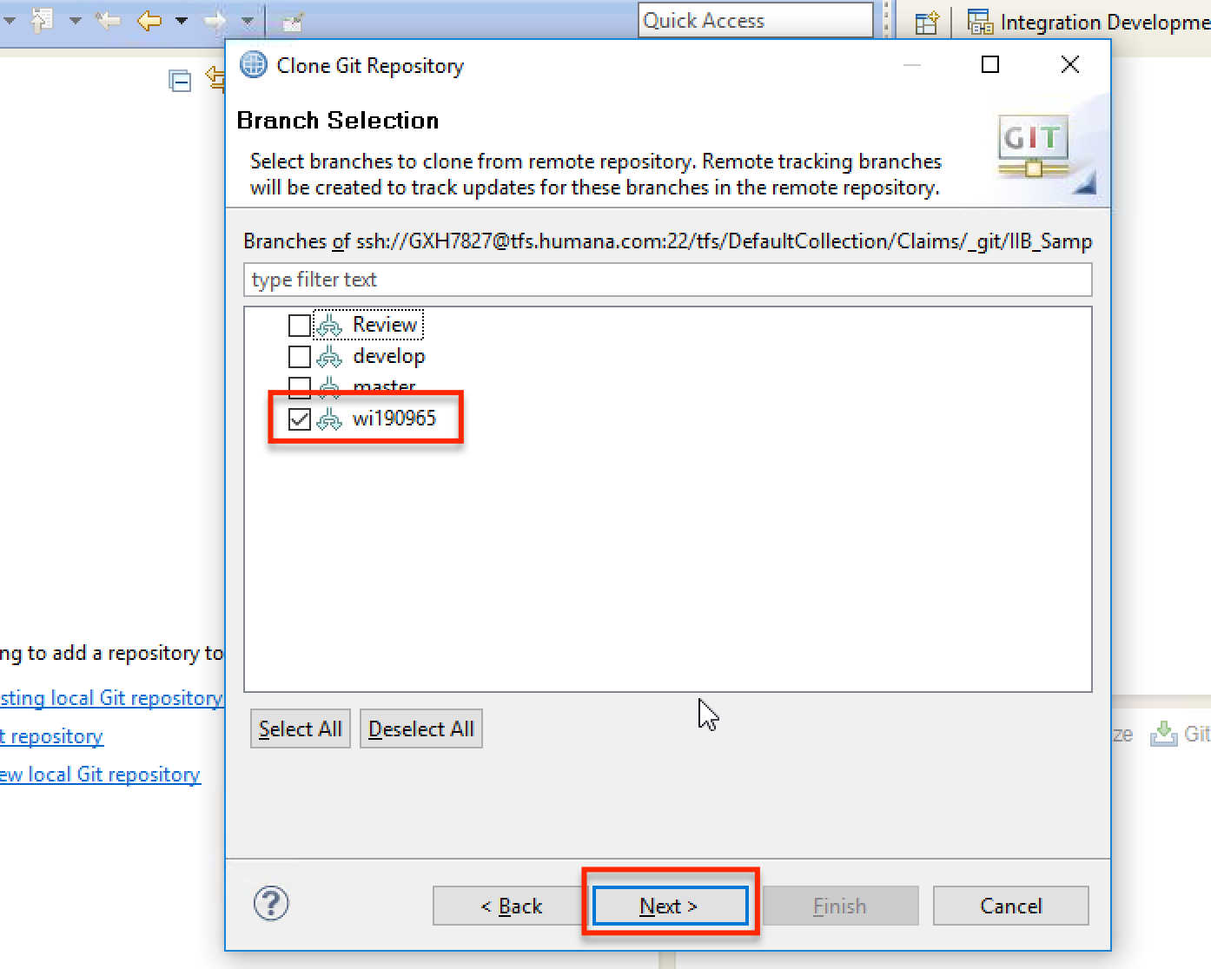
2. Clone branch – Select branch to work on

Slide 17
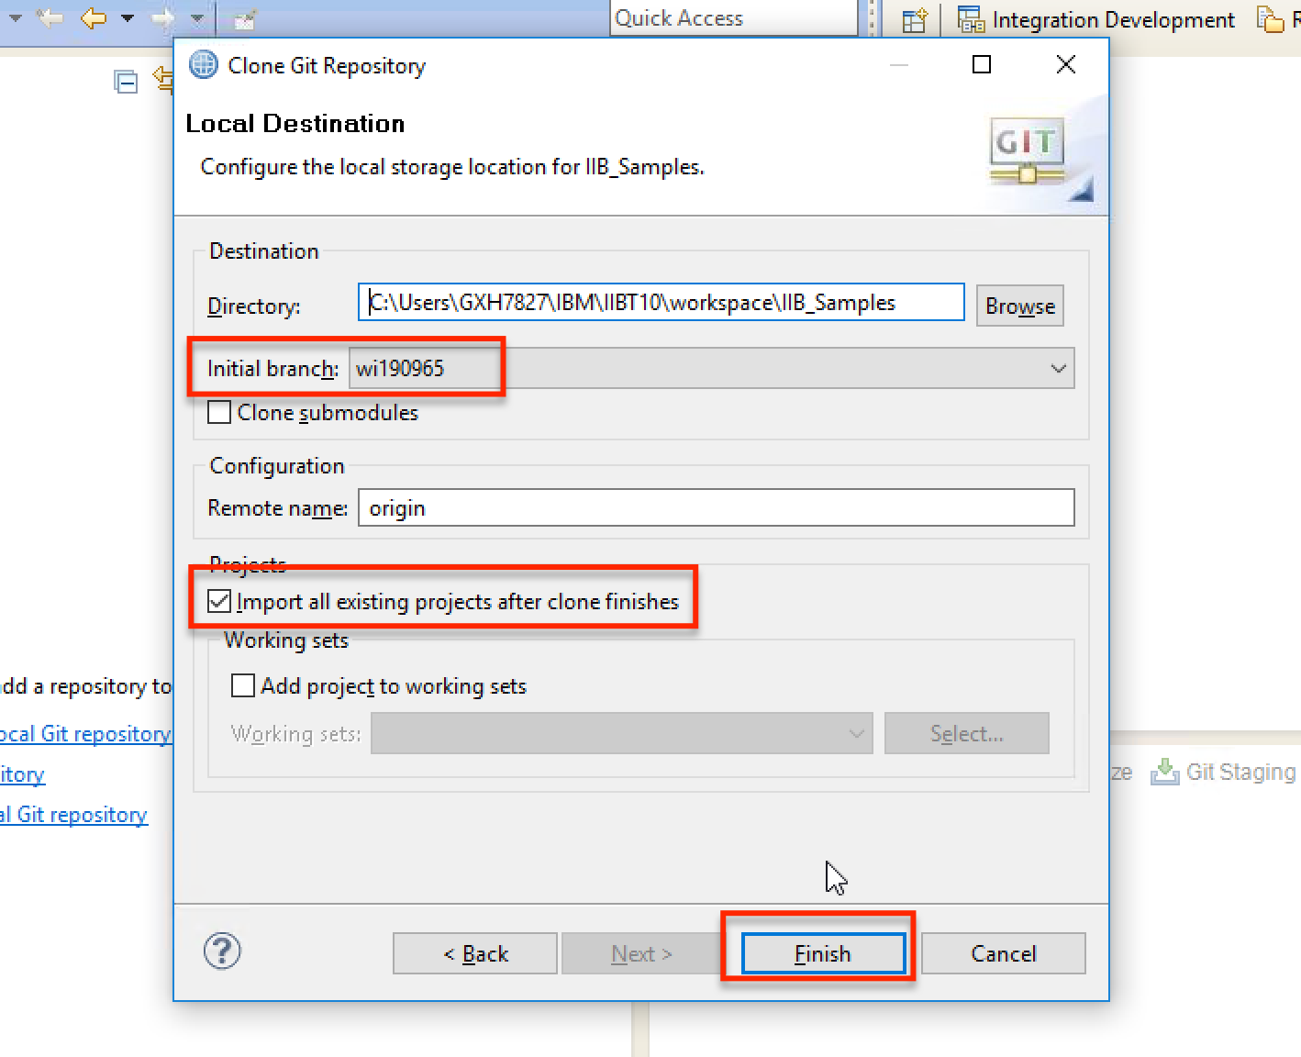
2. Clone branch – Finish clone

Slide 18
3. Work on new branch
Create a new workspace for the branch and clone the branch into that workspace.

Slide 19
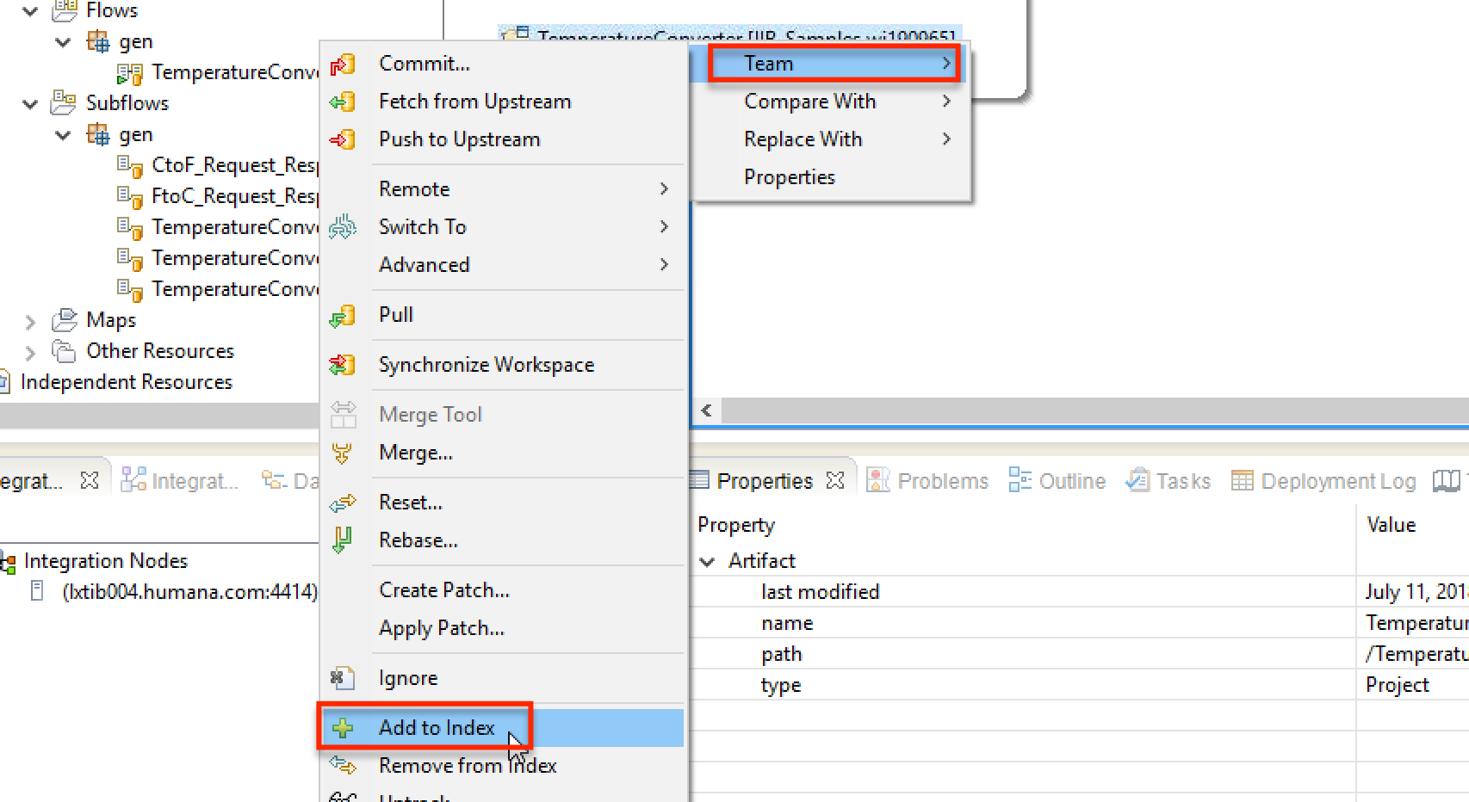
4. Commit changes – Add to index

Slide 20
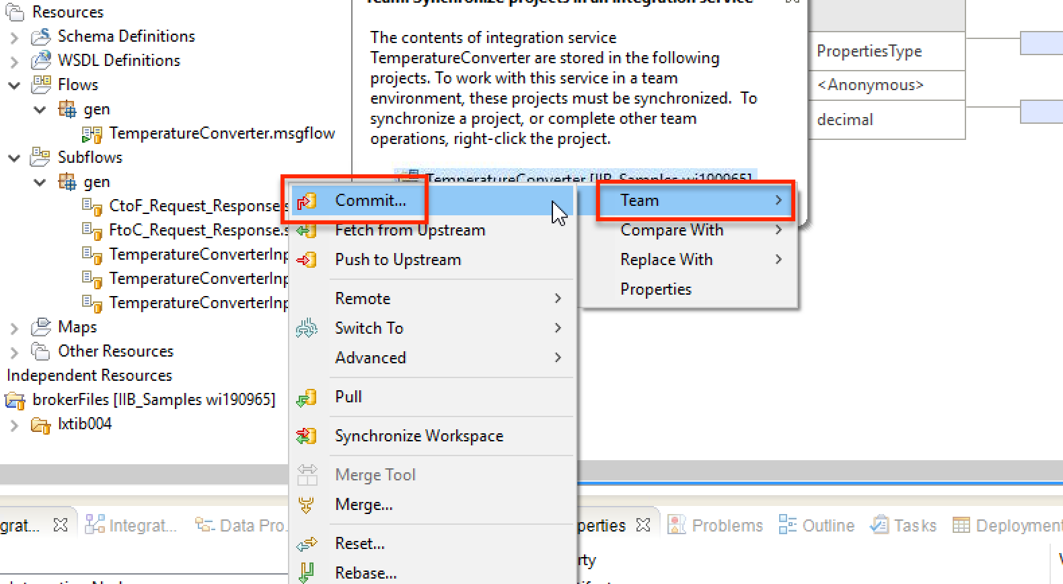
4. Commit changes – Select commit

Slide 21
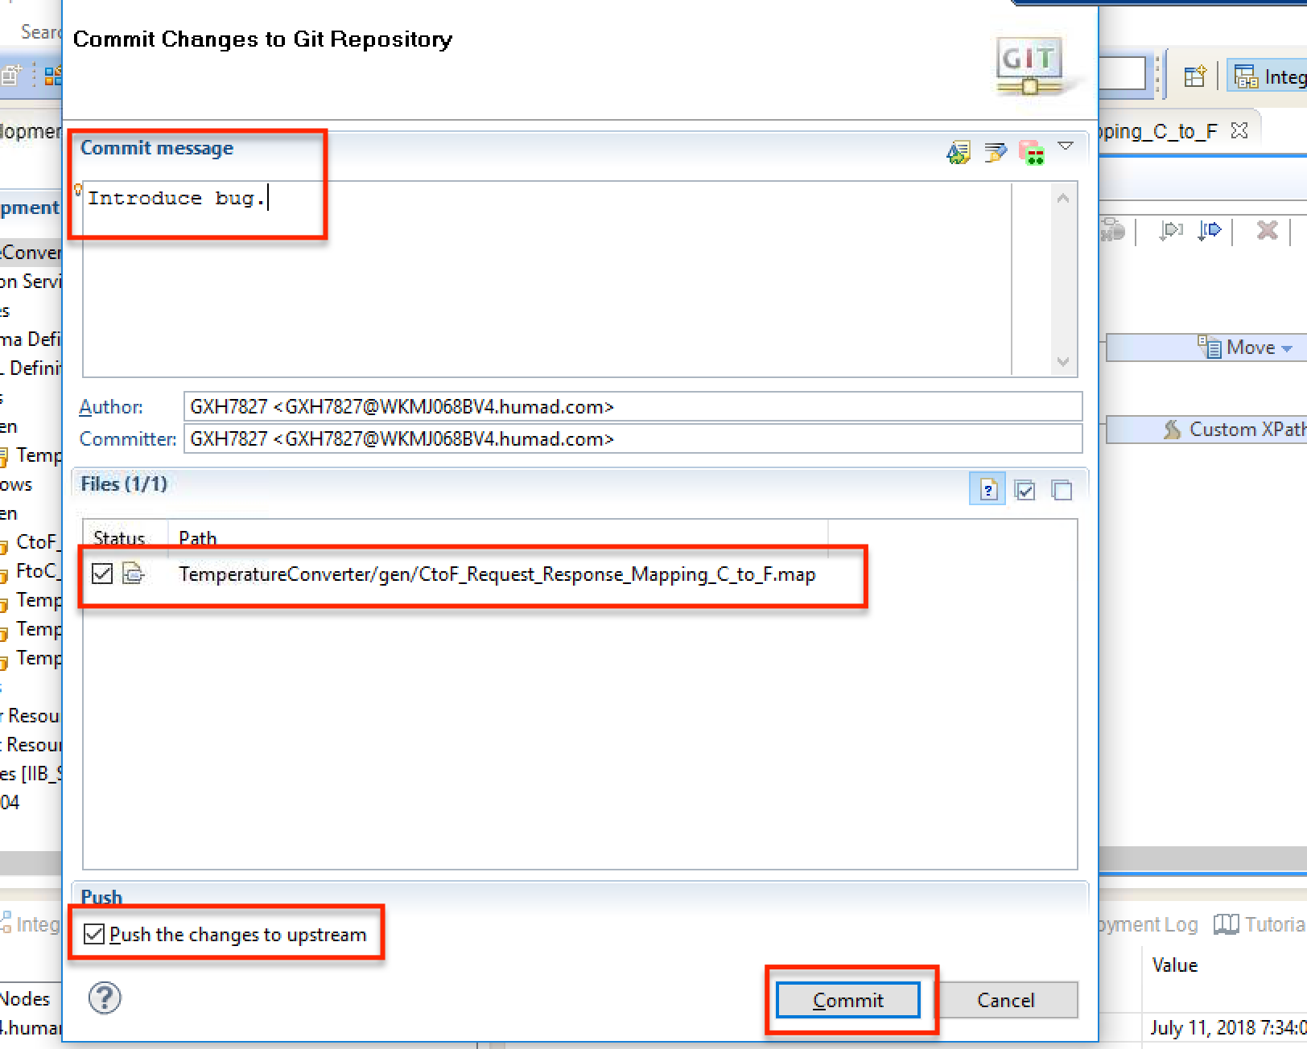
4. Commit changes – Commit with push

Slide 22
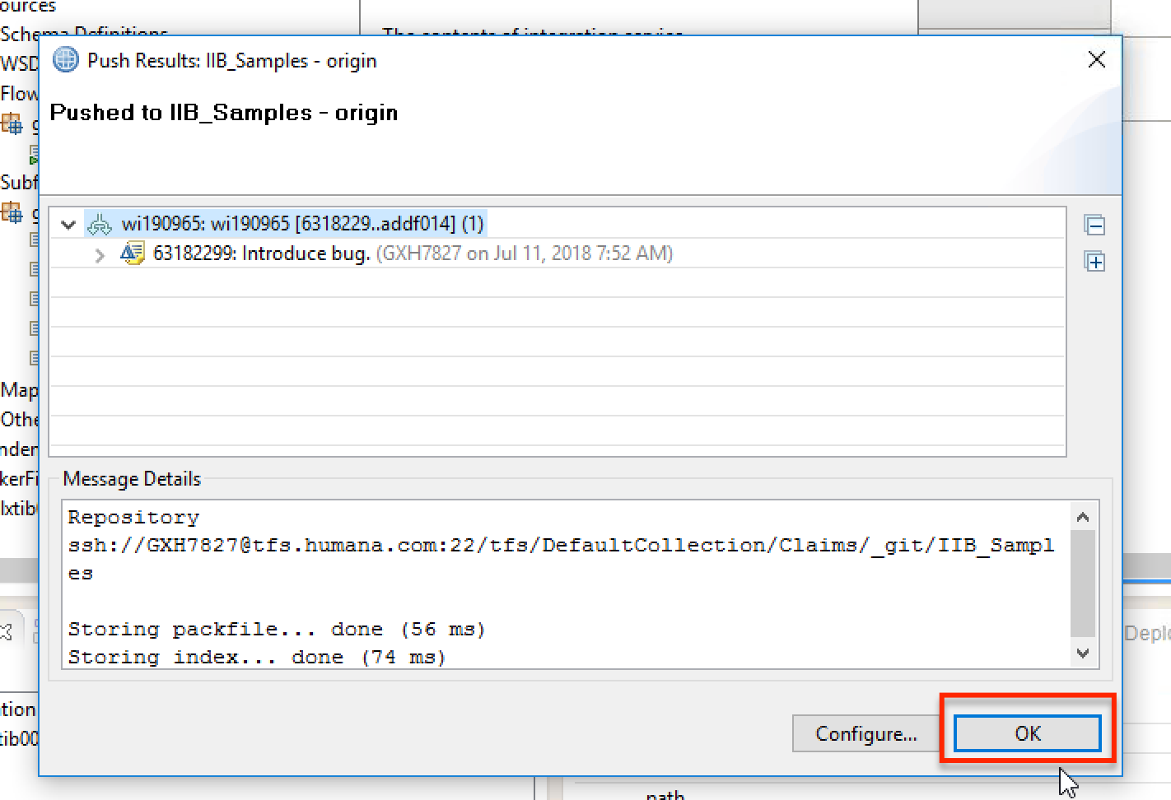
4. Commit changes – Review push to finish commit workflow

Slide 23
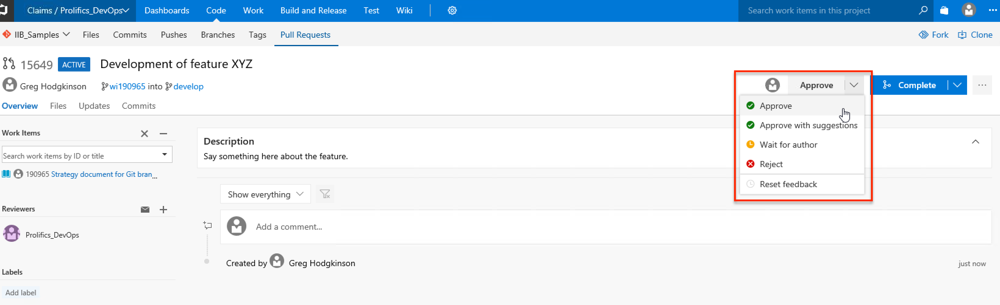
5. Merge branch with pull request - Approval

Slide 24
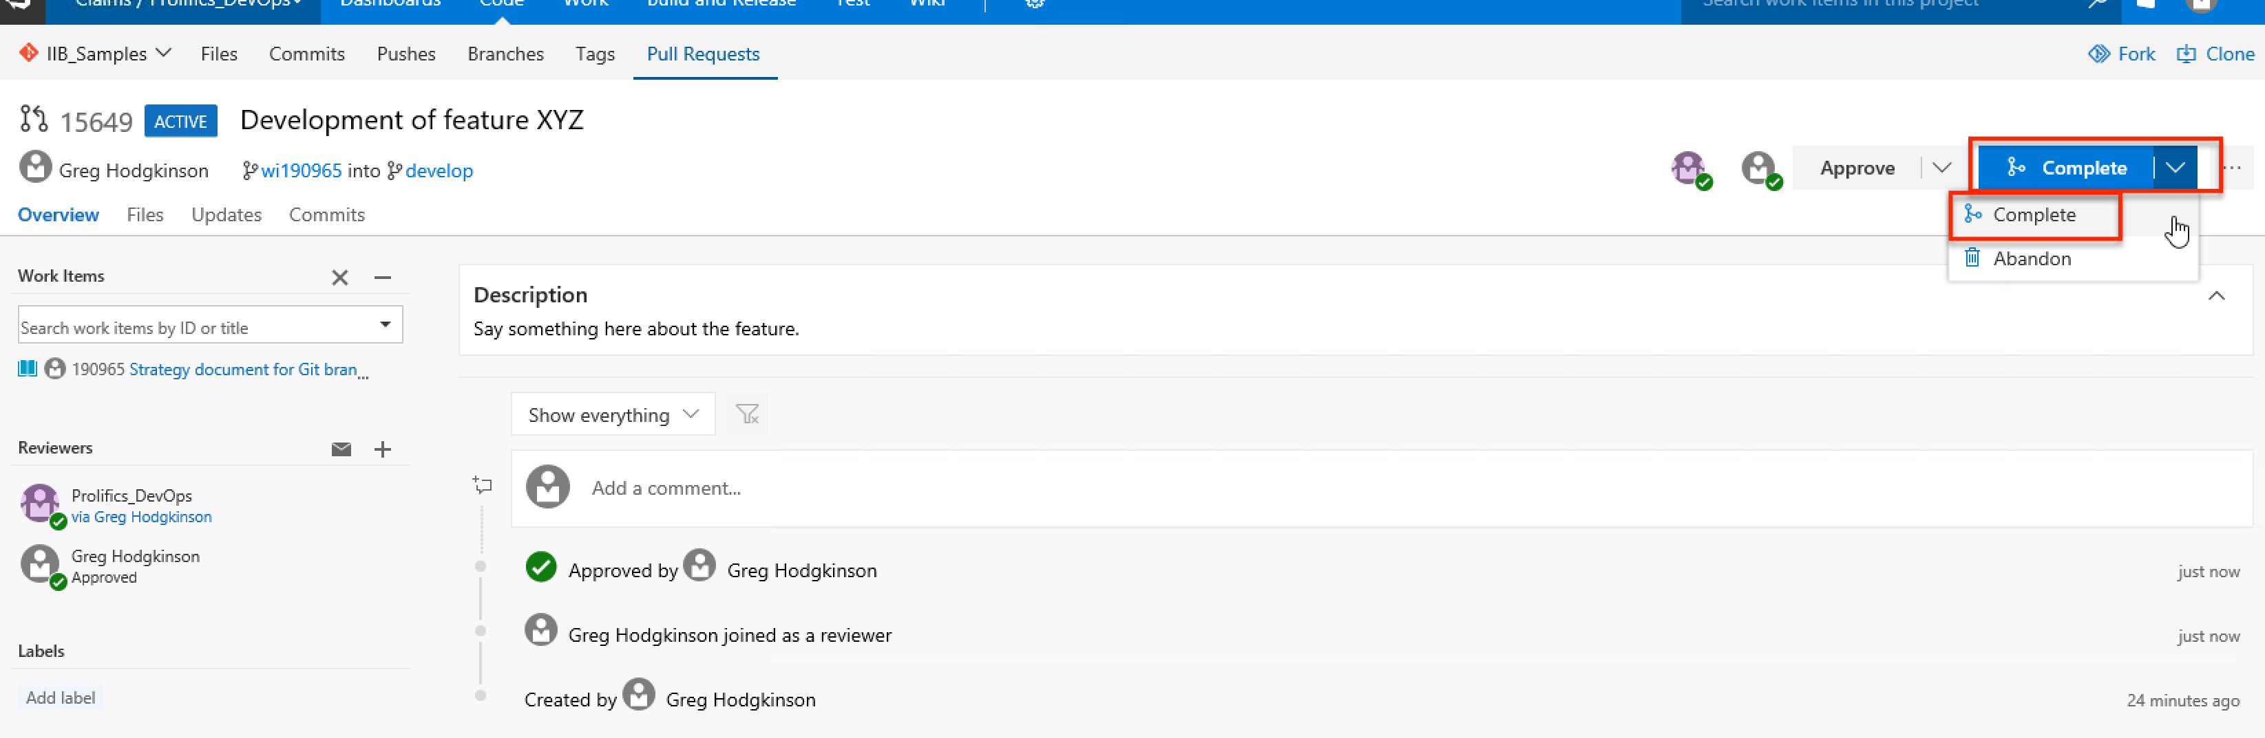
5. Merge branch with pull request – Select complete

Slide 25
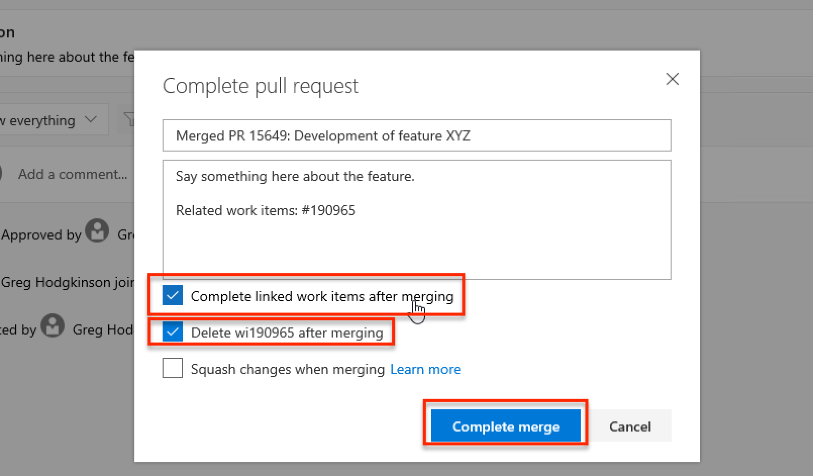
5. Merge branch with pull request – Complete merge with deletion of branch (merged in)

Slide 26
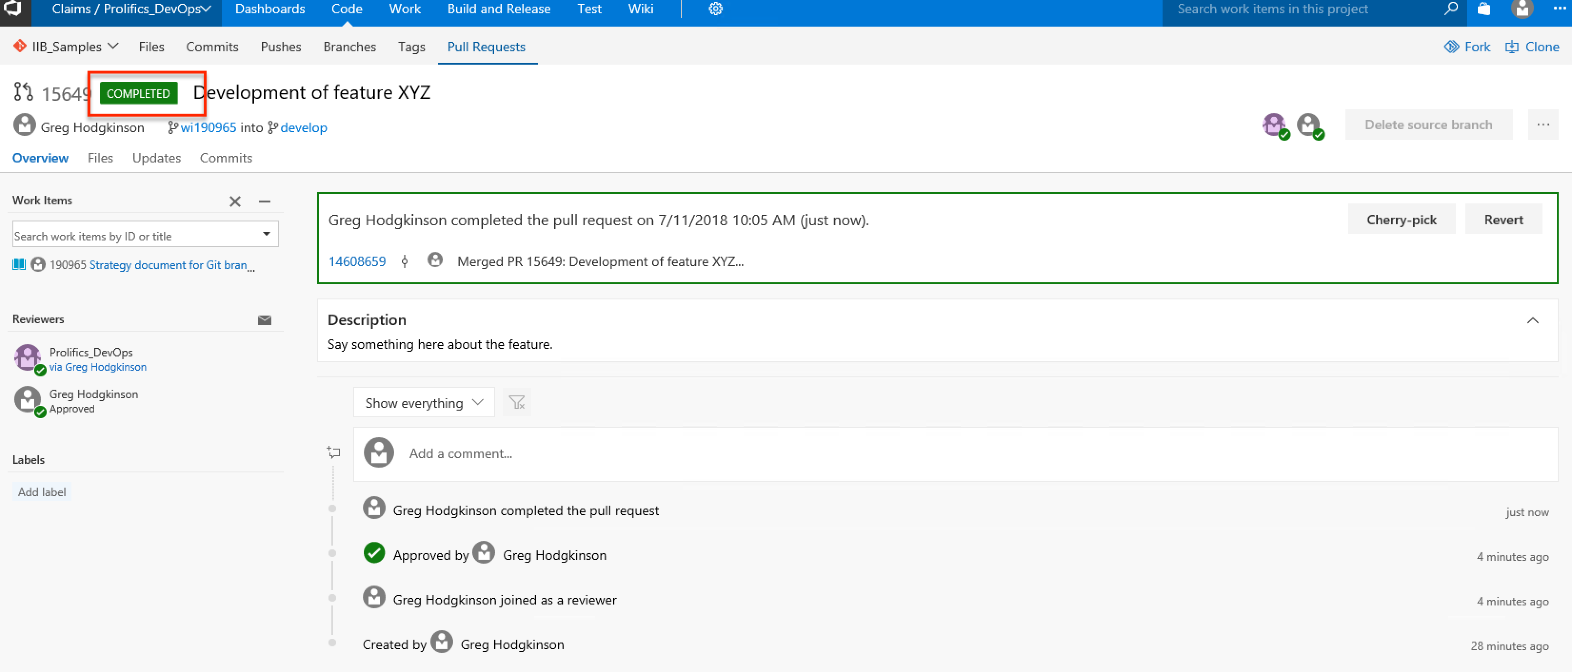
5. Merge branch with pull request - Completed

Slide 27
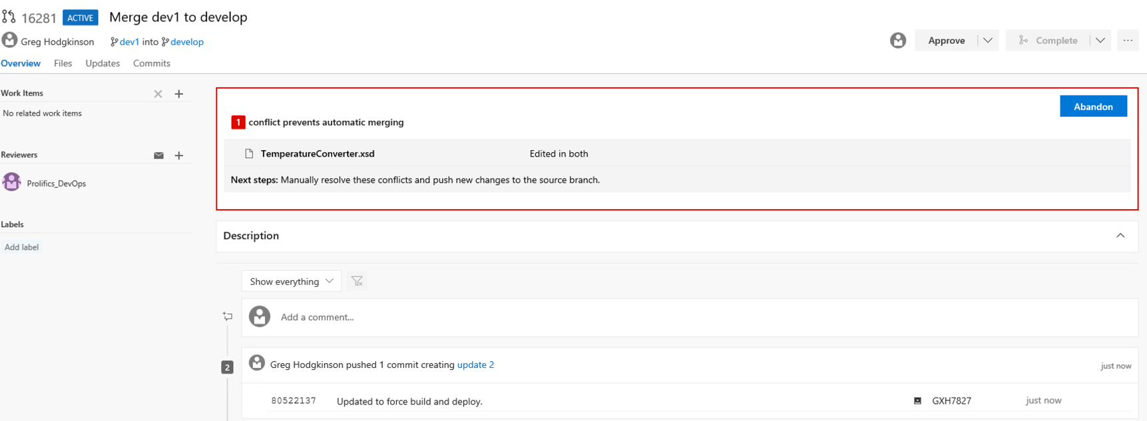
6. Merge conflict – Discover conflict

Slide 28
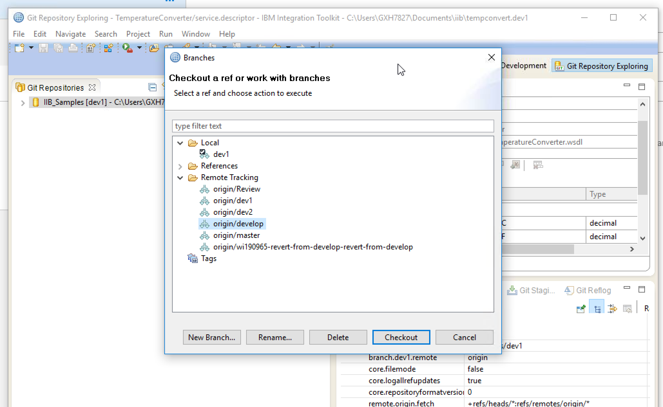
6. Merge conflict – Checkout develop

Slide 29
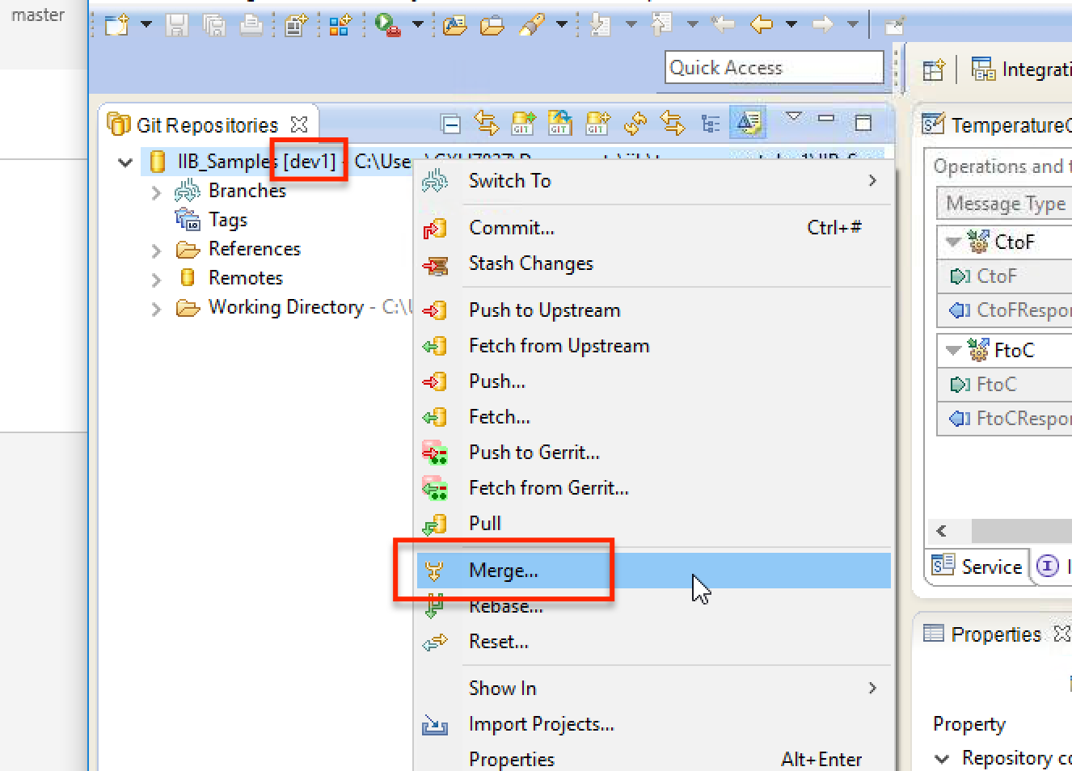
6. Merge conflict - Merge

Slide 30
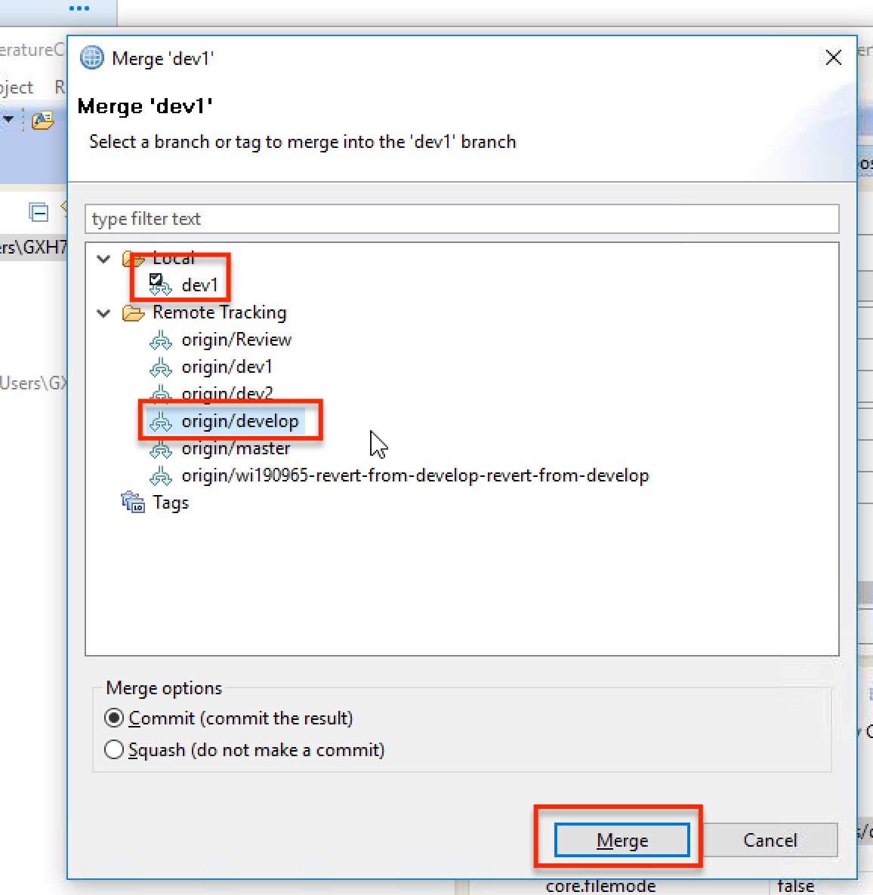
6. Merge conflict – Merge develop into dev1

Slide 31
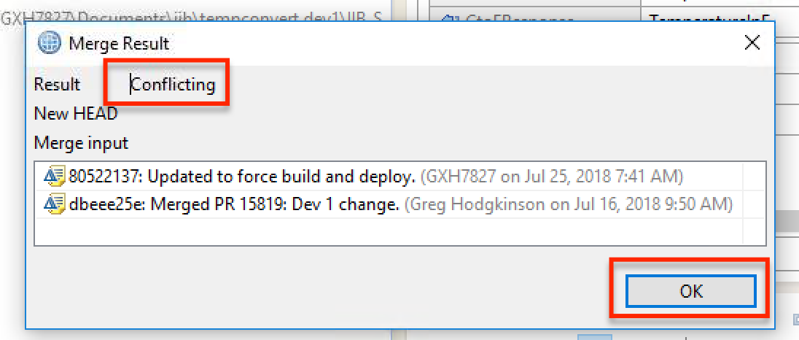
6. Merge conflict – Note conflicting

Slide 32
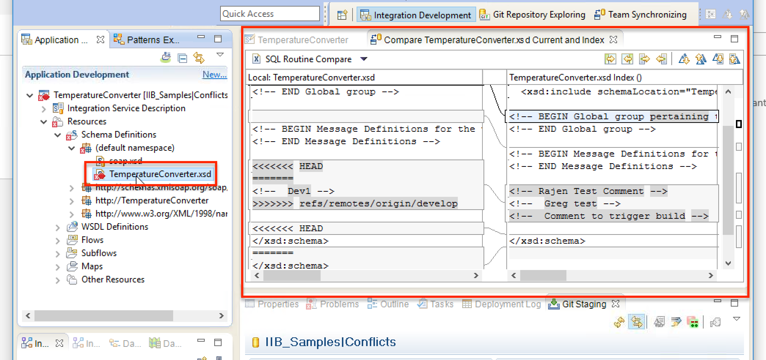
6. Merge conflict – Compare files

Slide 33
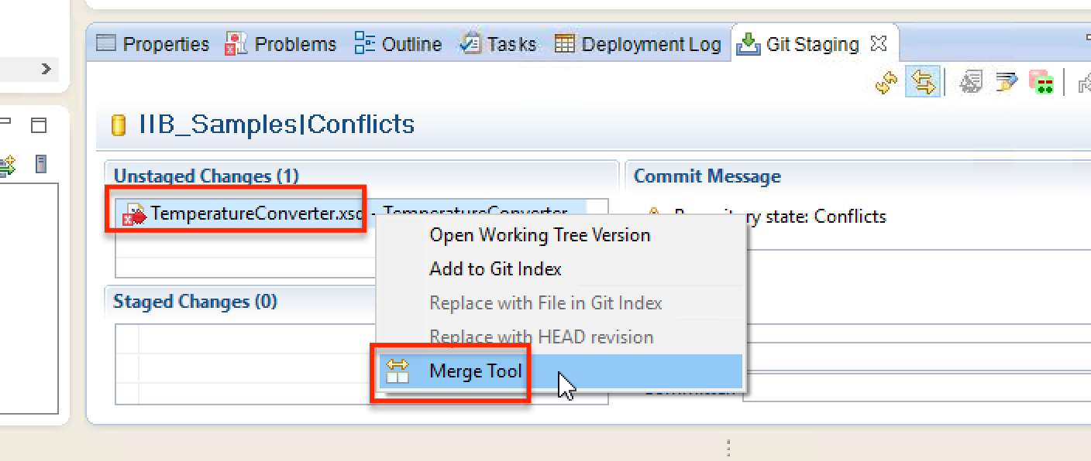
6. Merge conflict – Merge tool

Slide 34
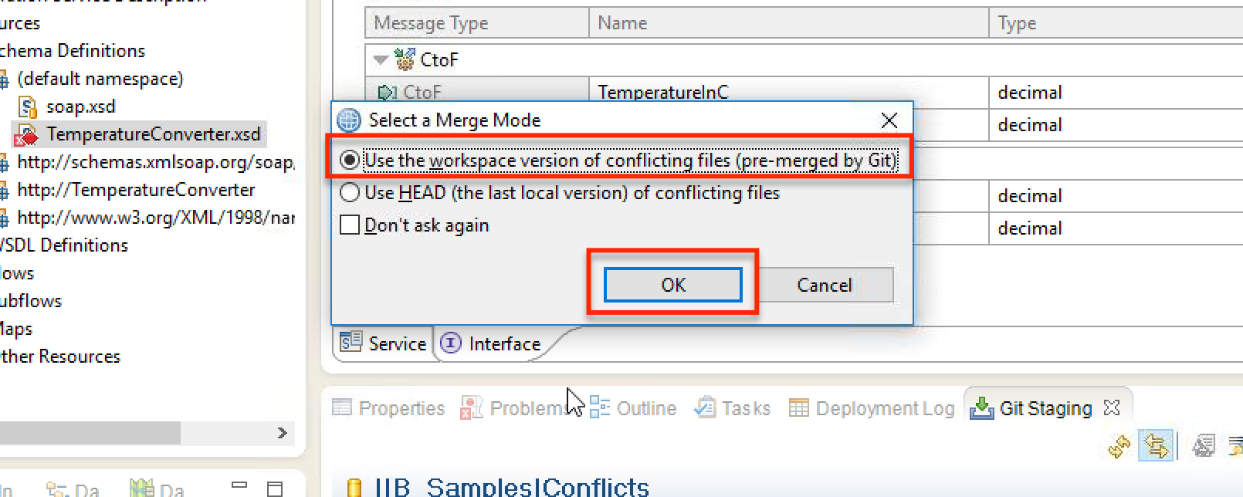
6. Merge conflict – Use workspace version

Slide 35
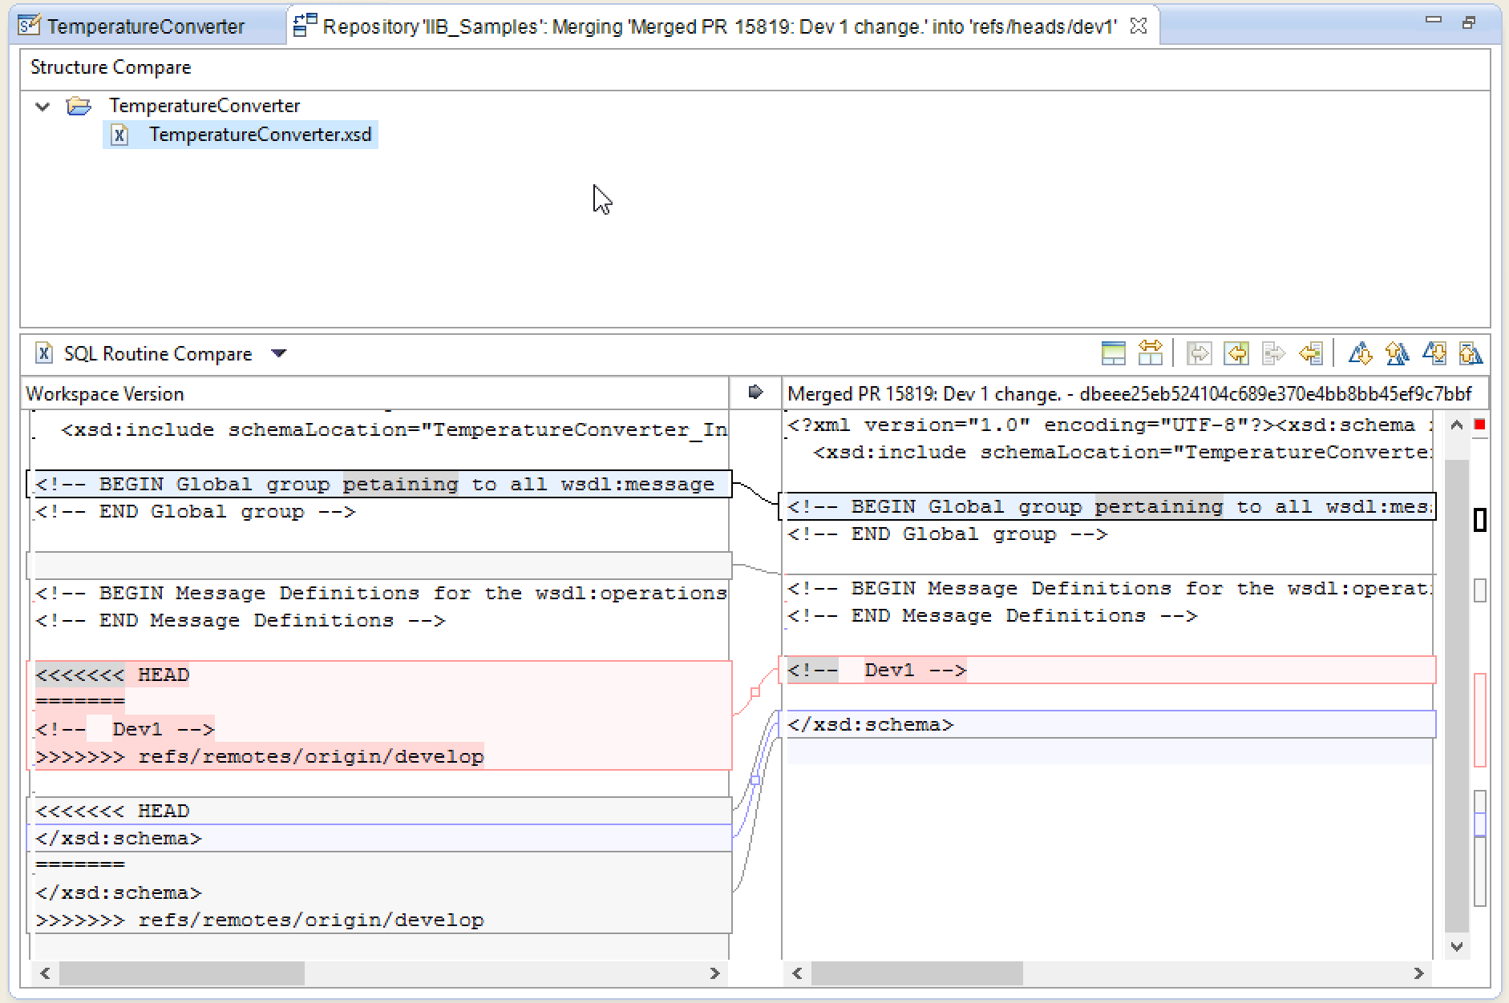
6. Merge conflict – Resolve conflict

Slide 36
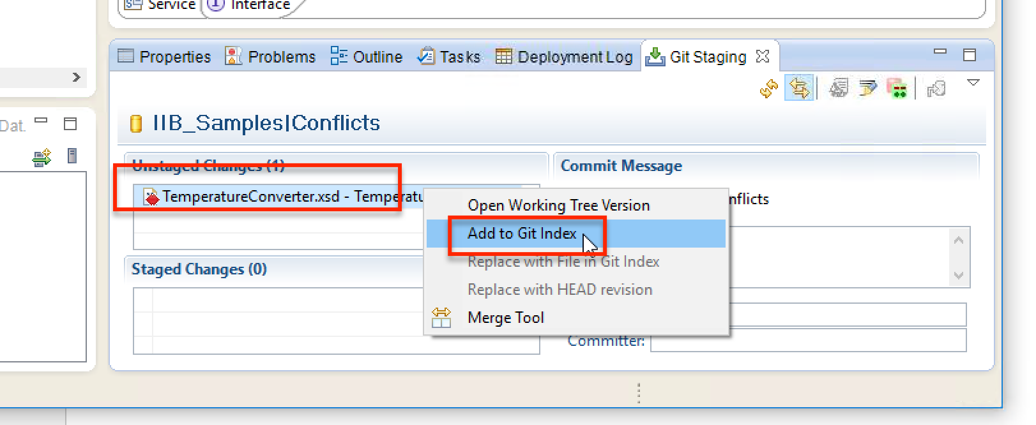
6. Merge conflict – Add to index

Slide 37
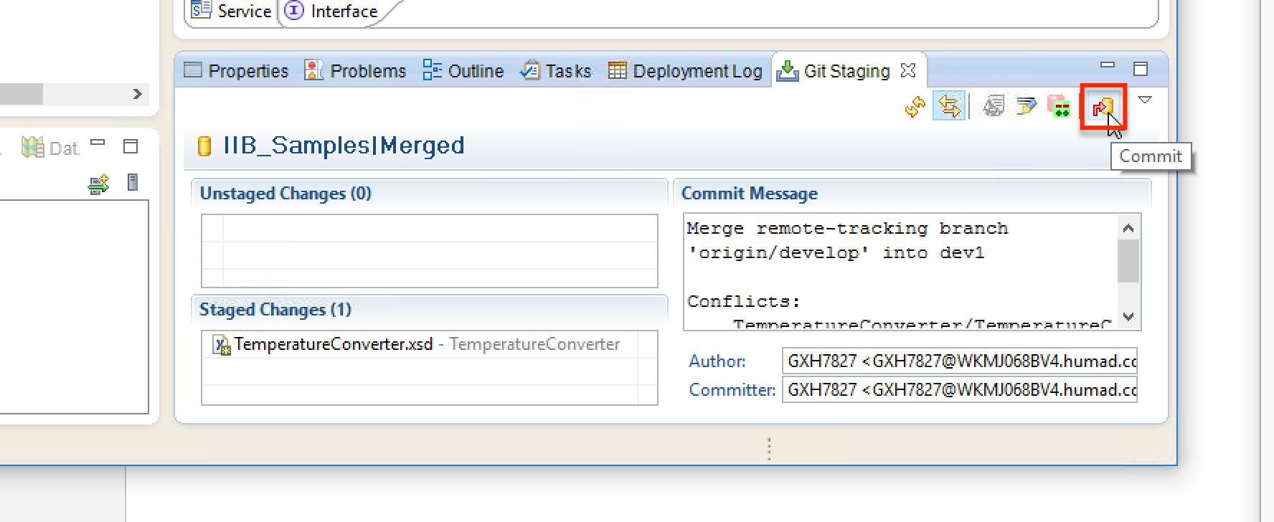
6. Merge conflict - Commit

Slide 38
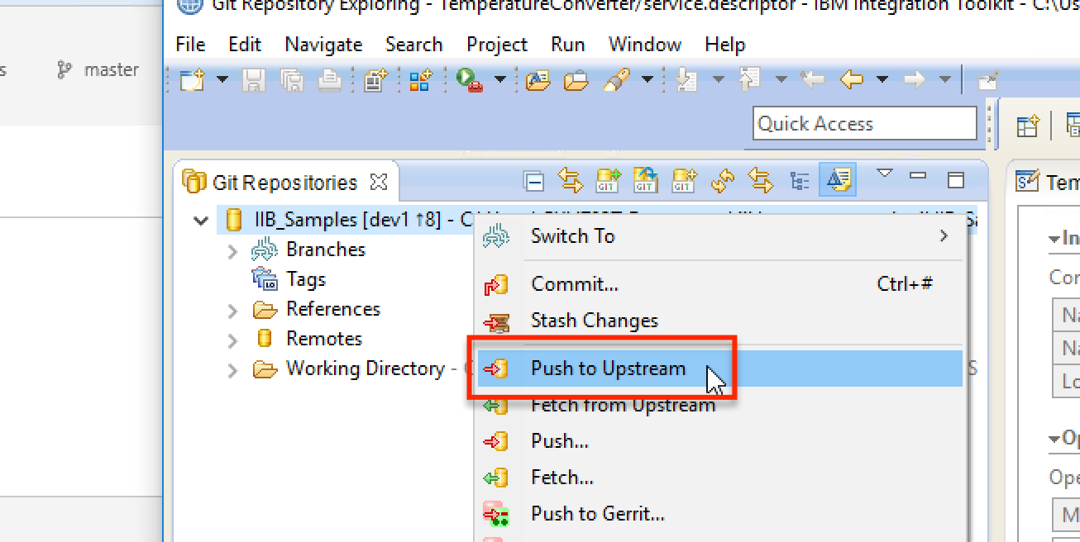
6. Merge conflict – Push to upstream

Slide 39
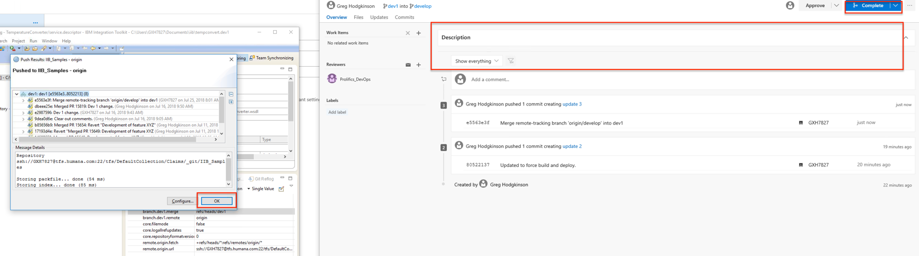
6. Merge conflict – Conflict is gone, complete

Slide 40
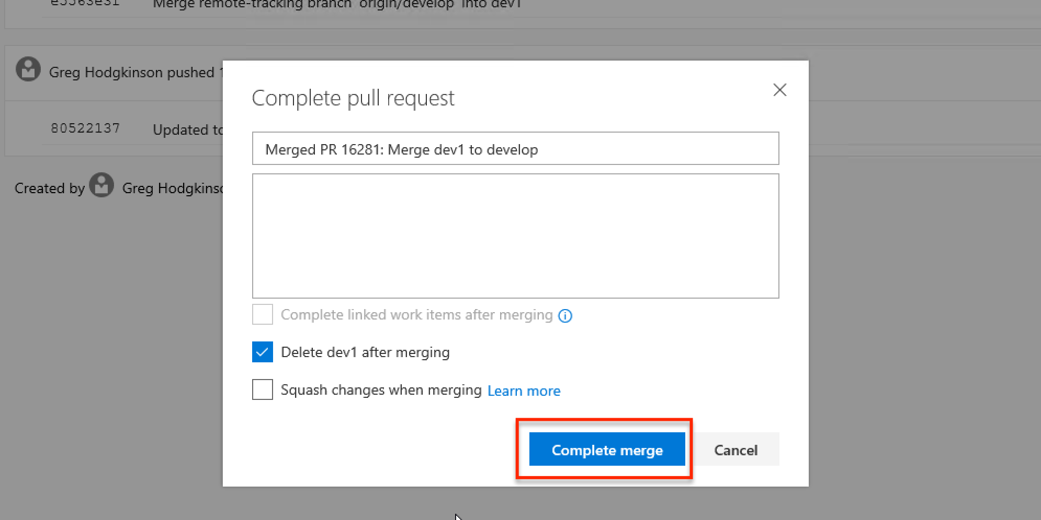
6. Merge conflict – Complete merge

Slide 41
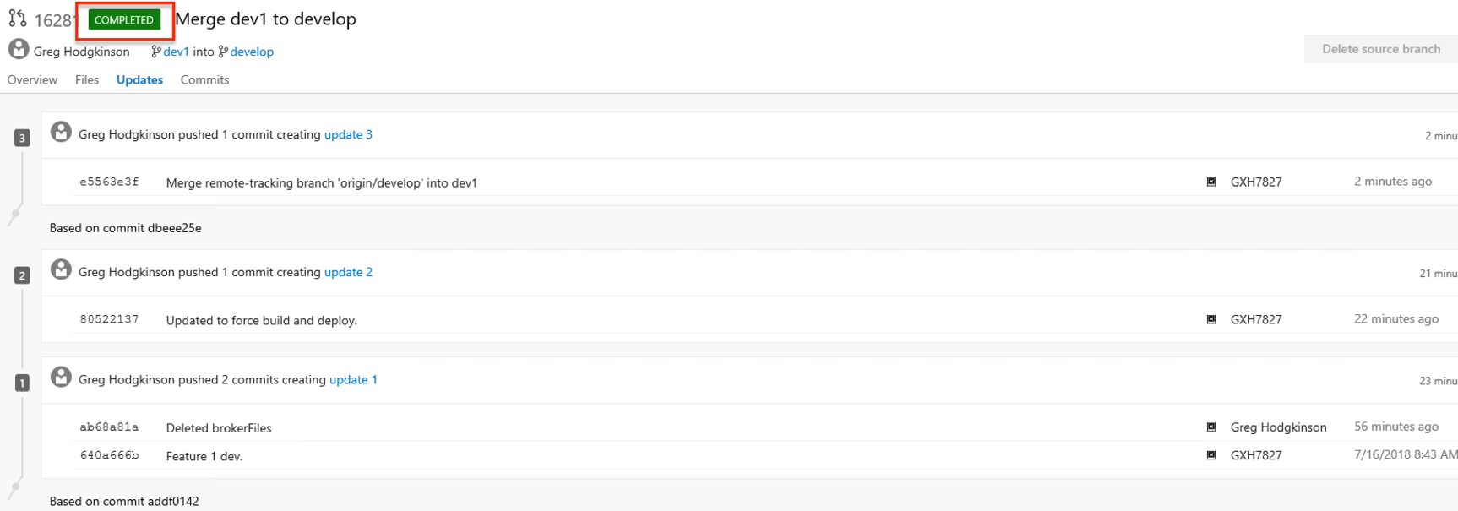
6. Merge conflict - Completed

Slide 42
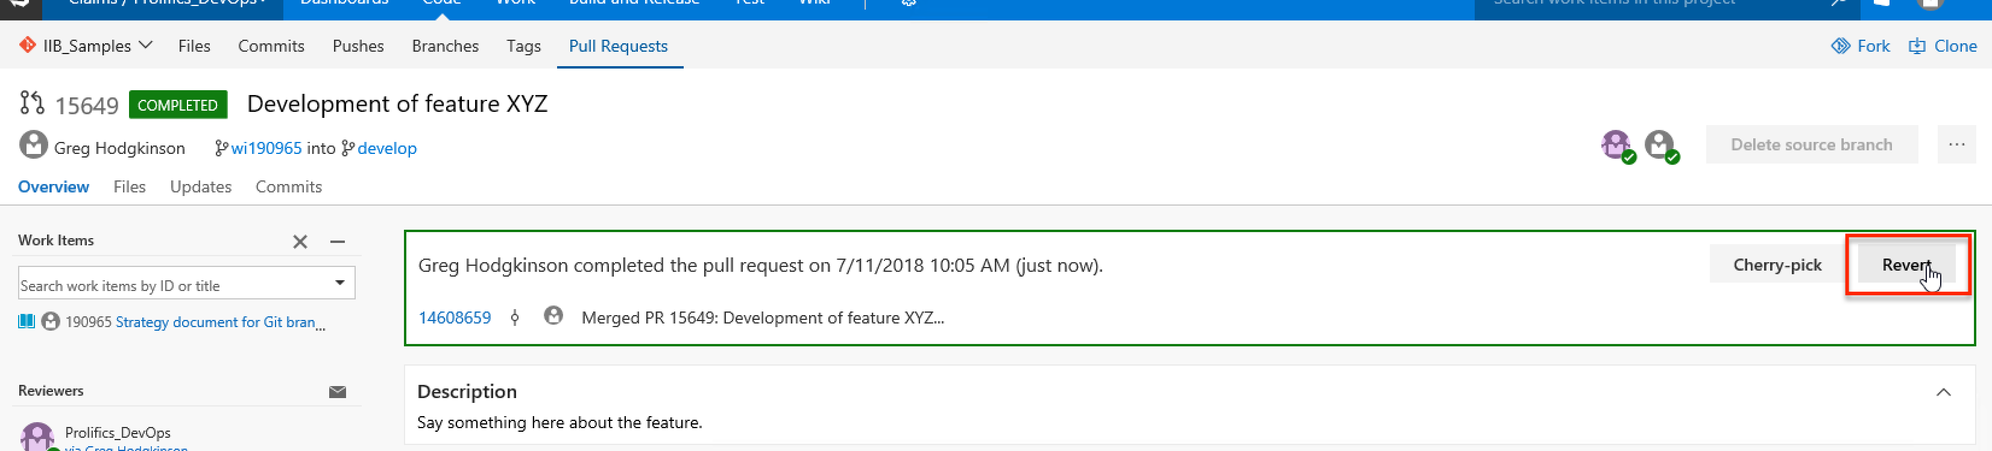
7. Rollback merge – Select revert command in TFS

Slide 43
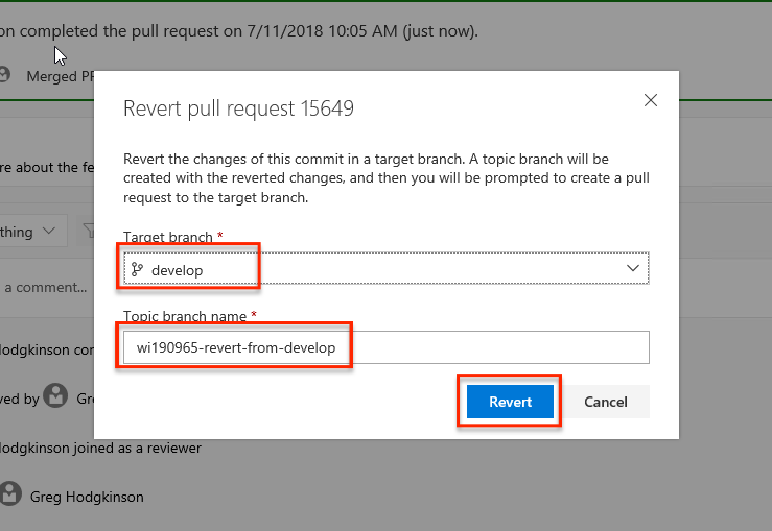
7. Rollback merge – Create revert topic branch

Slide 44
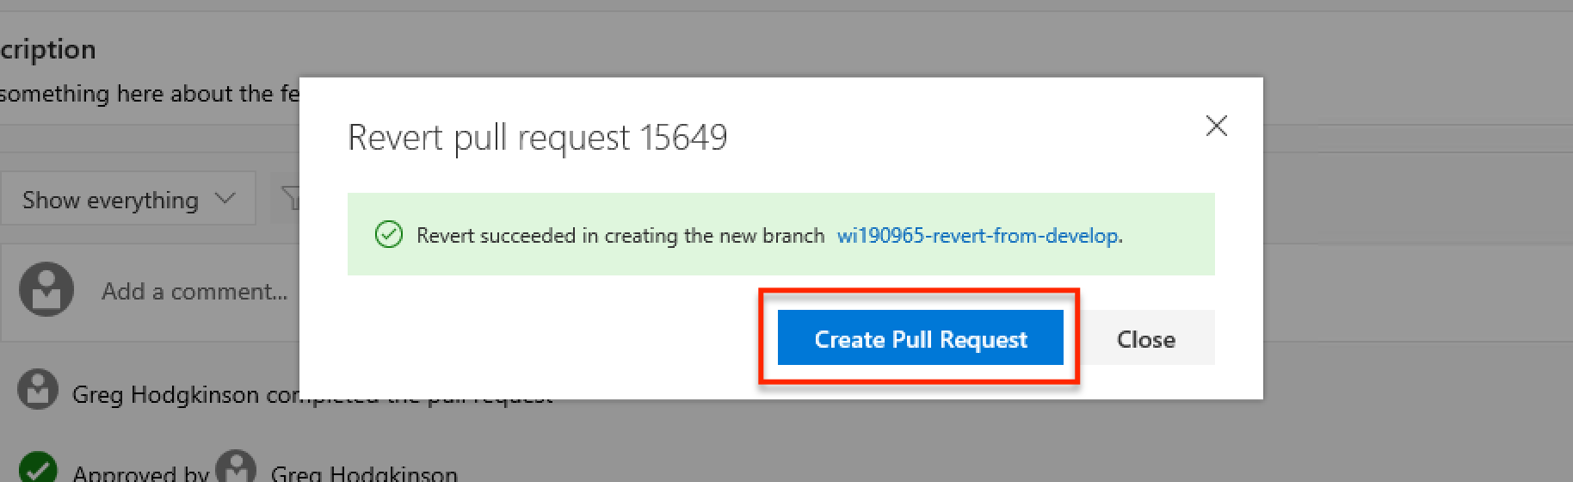
7. Rollback merge – Create revert pull request for revert topic branch

Slide 45
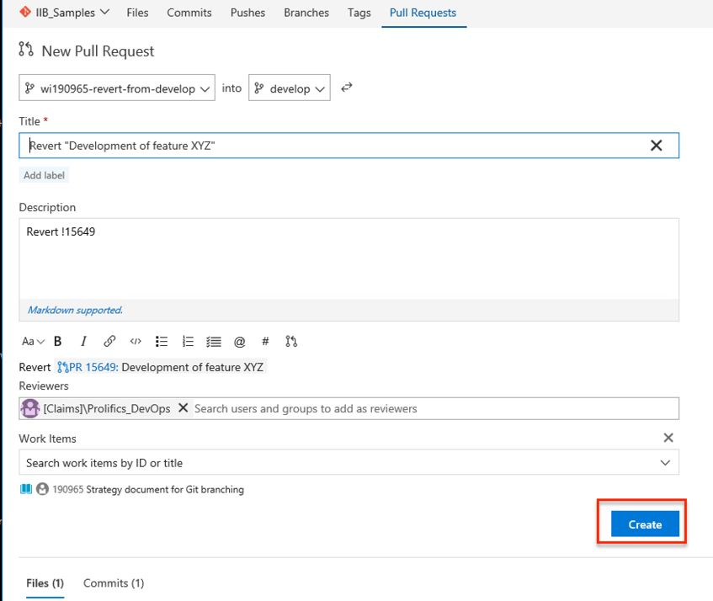
7. Rollback merge – Complete creation of revert topic branch pull request

Slide 46
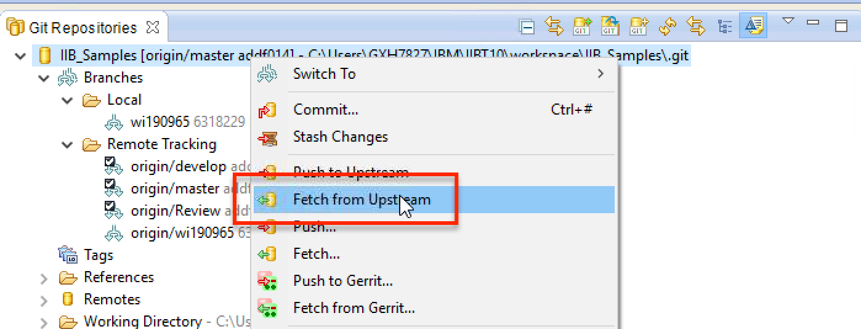
7. Rollback merge – Fetch new revert topic branch from upstream

Slide 47
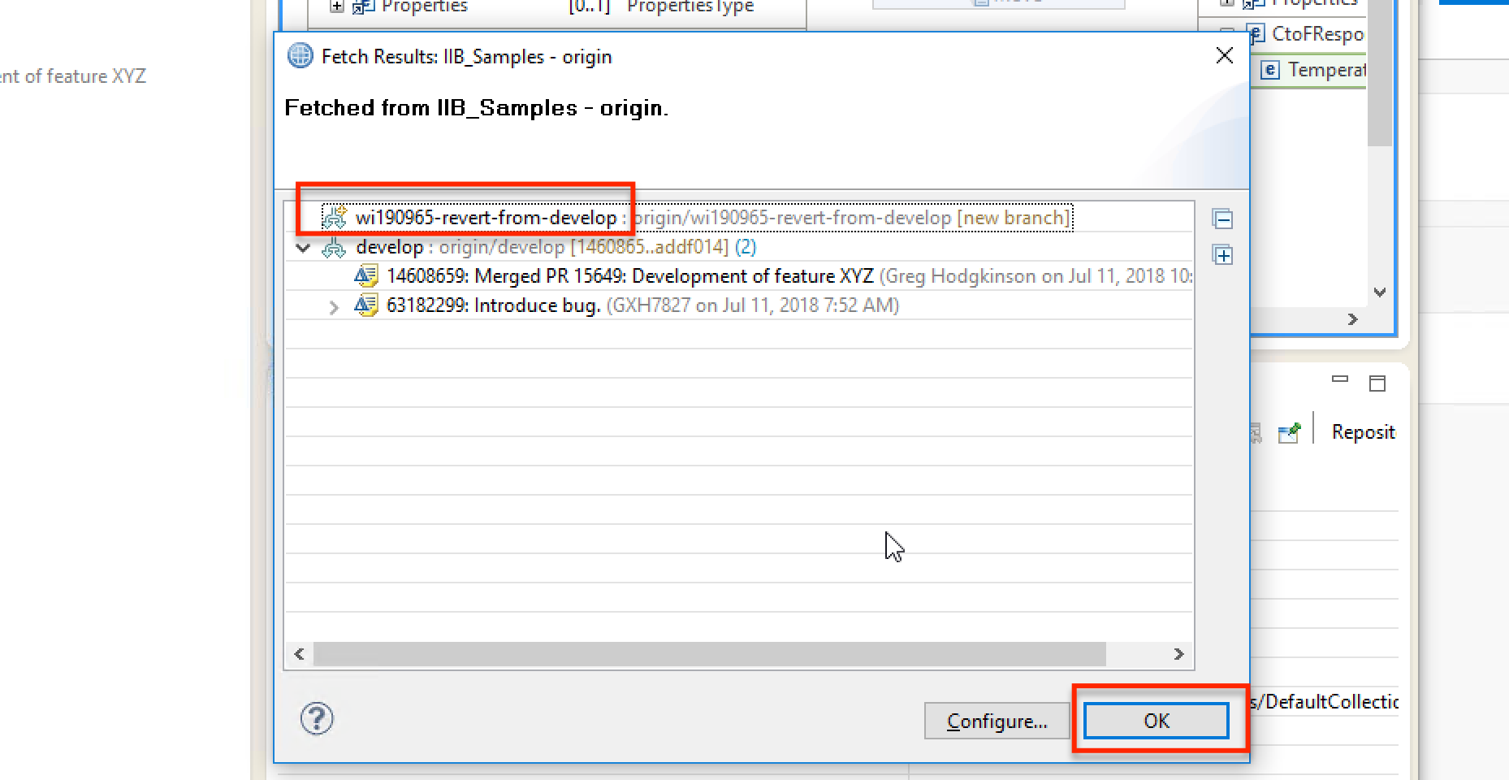
7. Rollback merge – Review fetched revert topic branch

Slide 48
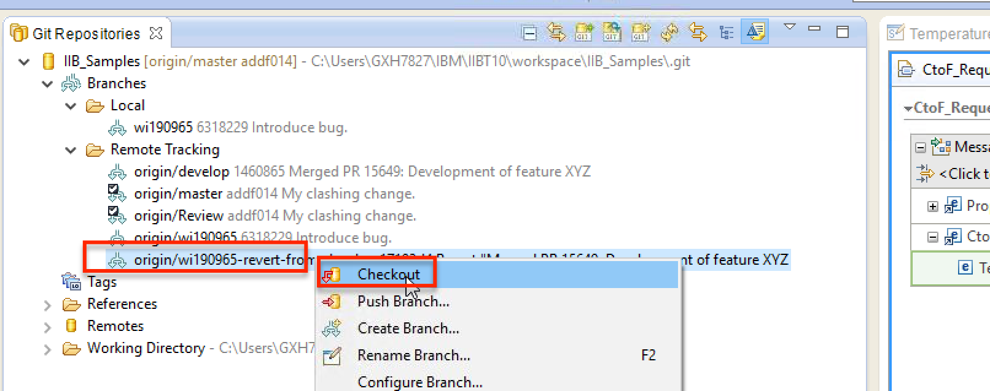
7. Rollback merge – Checkout revert topic branch

Slide 49
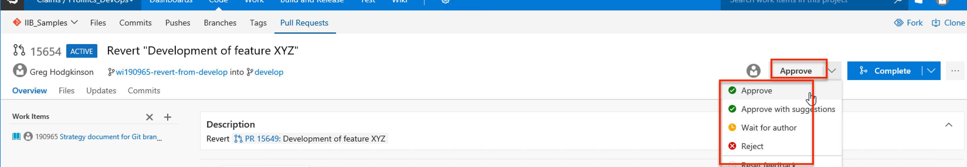
7. Rollback merge – Approve revert pull request

Slide 50
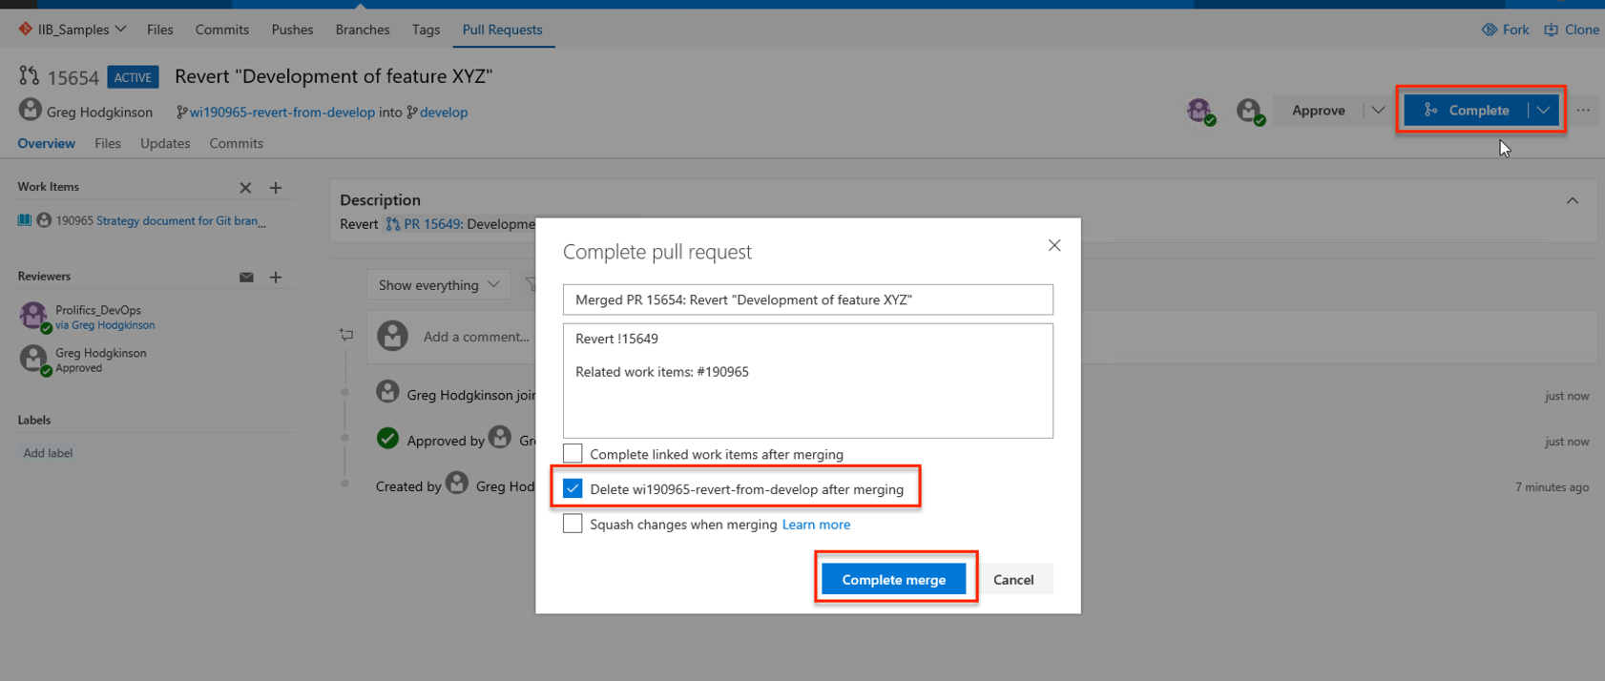
7. Rollback merge – Complete merge of revert pull request

Slide 51
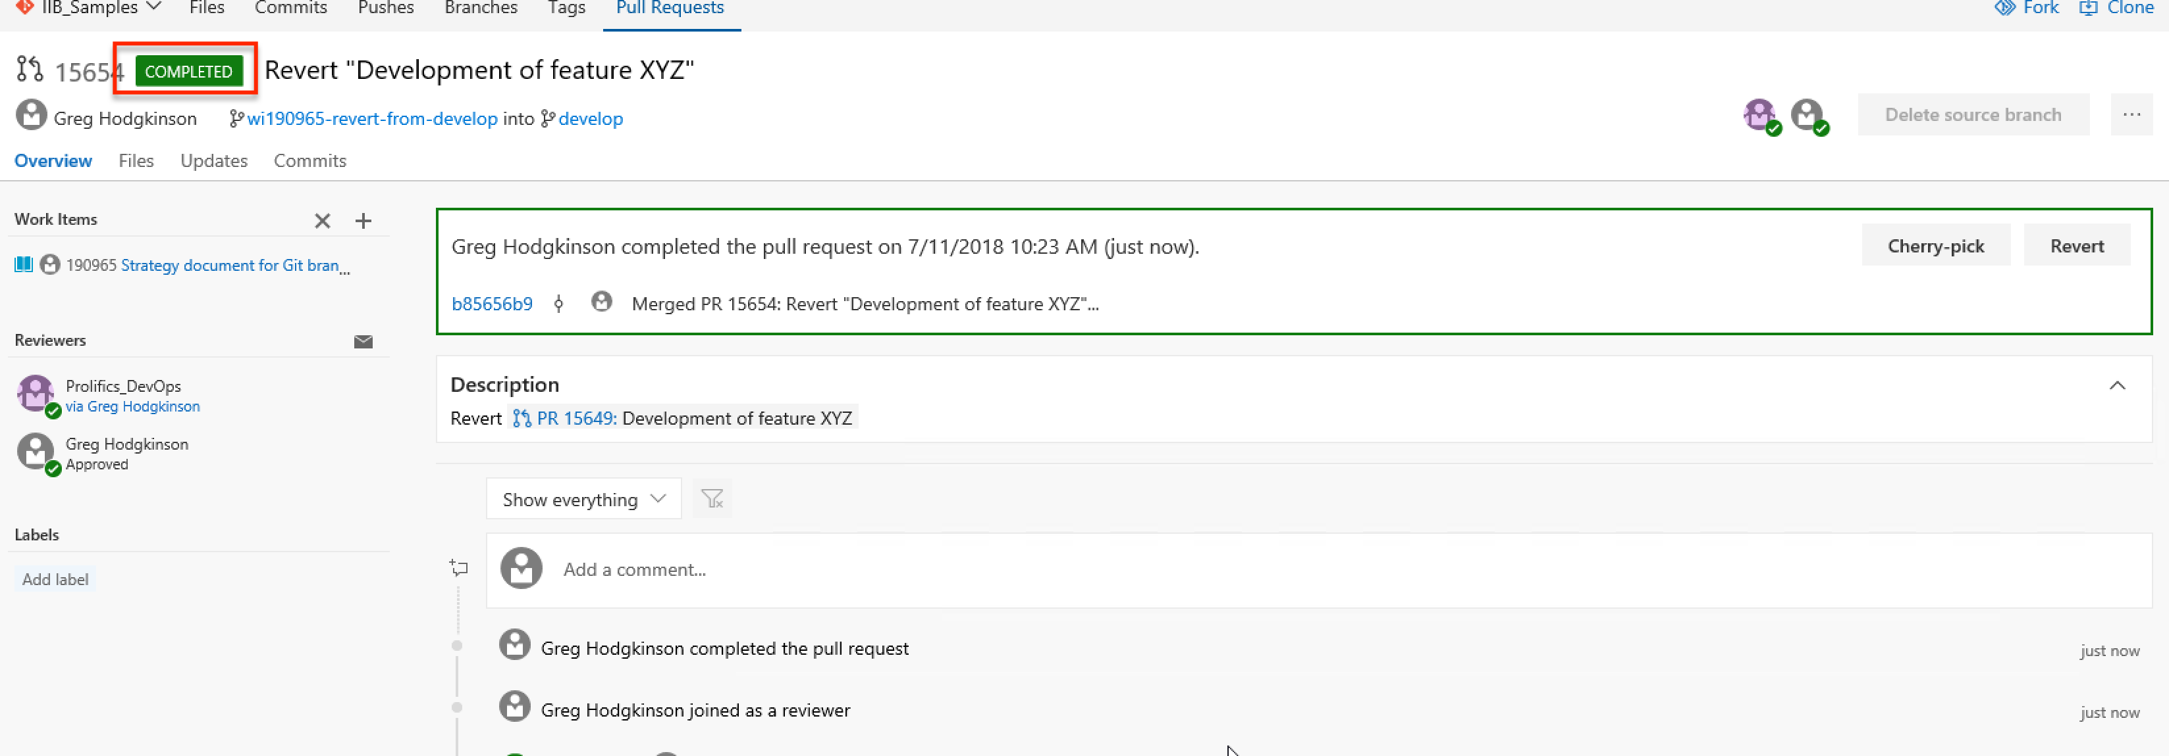
7. Rollback merge – View completed revert pull request

